Slide 1
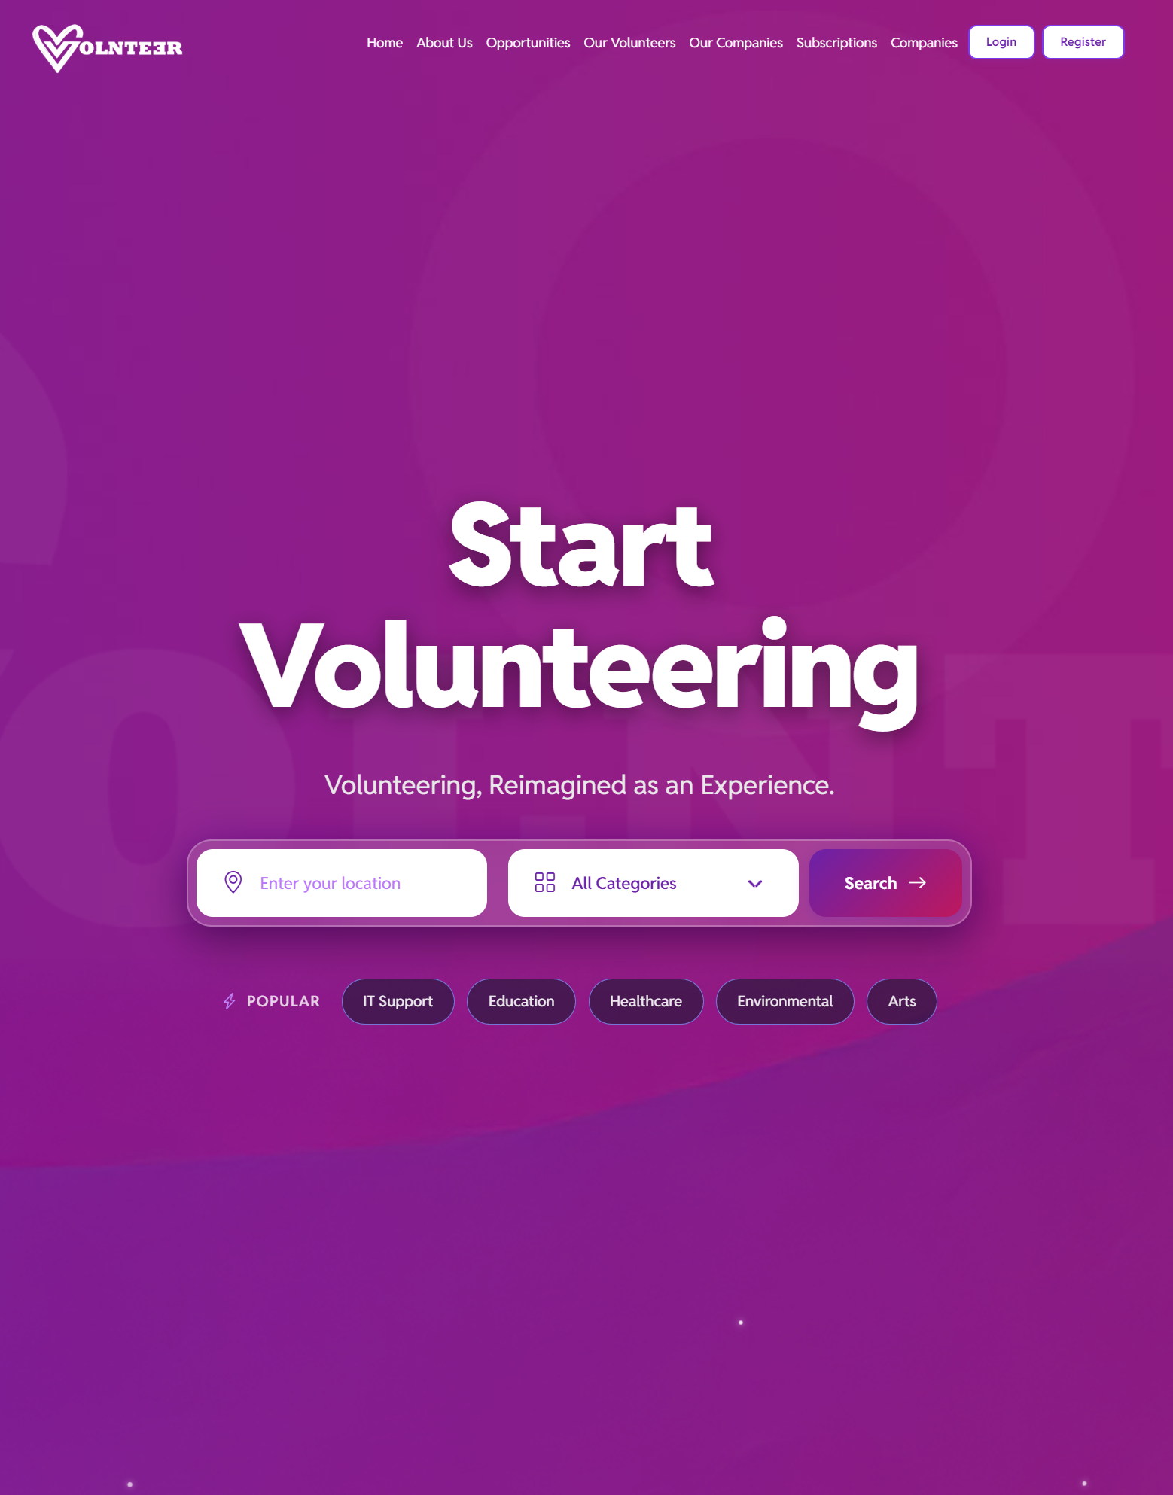




Turn Employee Volunteering Into Measurable Business Value
Improve retention and engagement through purpose-led programmes
Replace spreadsheets with one operational workflow
Show board-ready CSR outcomes with confidence
Notes:
Volnteer turns good intentions into measurable business outcomes—faster engagement, lower admin, and visible impact.

Slide 2




THE PROBLEM
Most Corporate Volunteering
Is Fragmented
Disconnected Tools
Roles, applications, and hour tracking live in separate tools with no unified view.
High Admin, Low Accuracy
Manual effort leads to inconsistent approvals and unreliable programme data.
Impact Is Hard to Prove
Turn Employee Volunteering Into Measurable Business Value
Without a system, ROI is invisible — making business and social return impossible to report.
"Without a system, programmes become hard to scale, hard to govern, and hard to justify."
Improve retention and engagement through purpose-led programmes
Replace spreadsheets with one operational workflow
Show board-ready CSR outcomes with confidence
Notes:
Volnteer turns good intentions into measurable business outcomes—faster engagement, lower admin, and visible impact.

Slide 3
THE PROBLEM
Most Corporate Volunteering
Is Fragmented
Disconnected Tools
Roles, applications, and hour tracking live in separate tools with no unified view.
High Admin, Low Accuracy
Improve retention and engagement through purpose-led programmes
Manual effort leads to inconsistent approvals and unreliable programme data.
Impact Is Hard to Prove
Without a system, ROI is invisible — making business and social return impossible to report.
"Without a system, programmes become hard to scale, hard to govern, and hard to justify."
Notes:
Without a system, programmes become hard to scale, hard to govern, and hard to justify.

Slide 4




OUR SOLUTION
Volnteer = One End-to-End
CSR Operations Platform
Publish Opportunities
Manage Pipeline & Placements
Create and post volunteer roles. Volunteers browse and apply directly.
Structured applicant stages from shortlist through to hired and placed.
Verify Hours
Generate Impact Analytics
Volunteers submit timesheets. Companies approve or reject with full audit trail.
Live KPI dashboard and one-click PDF exports for leadership and ESG reporting.
"Volnteer connects every stage — from role creation to board-level reporting."
Notes:
Volnteer connects every stage of your volunteering programme—from role creation to board-level reporting.

Slide 5

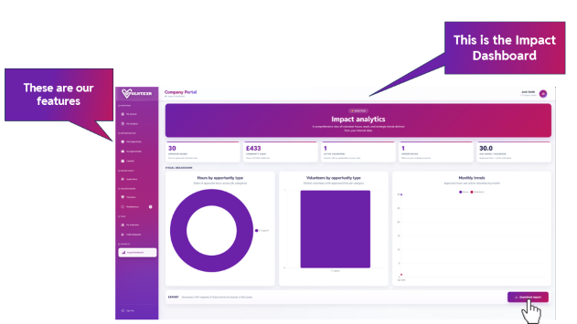
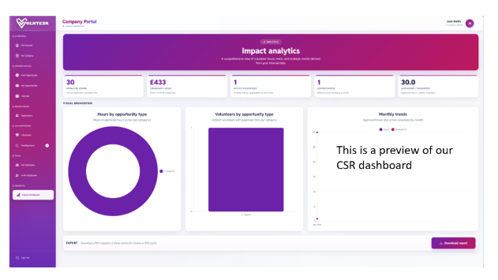
BUSINESS IMPACT
Retention Support
Why Leadership
Teams Buy In
Purpose-driven programmes deepen employee connection and reduce turnover.
Operational Efficiency
"We don't just help teams run volunteering—we help leadership see business value in real time."
Less manual admin and fewer process delays across HR and CSR teams.
Clear Value Tracking
Approved hours mapped to social impact metrics at £14.43/hr community value.
Strategic Visibility
Live KPIs for HR, CSR, and leadership — updated in real time.
Notes:
We don't just help teams run volunteering—we help leadership see business value in real time.

Slide 6
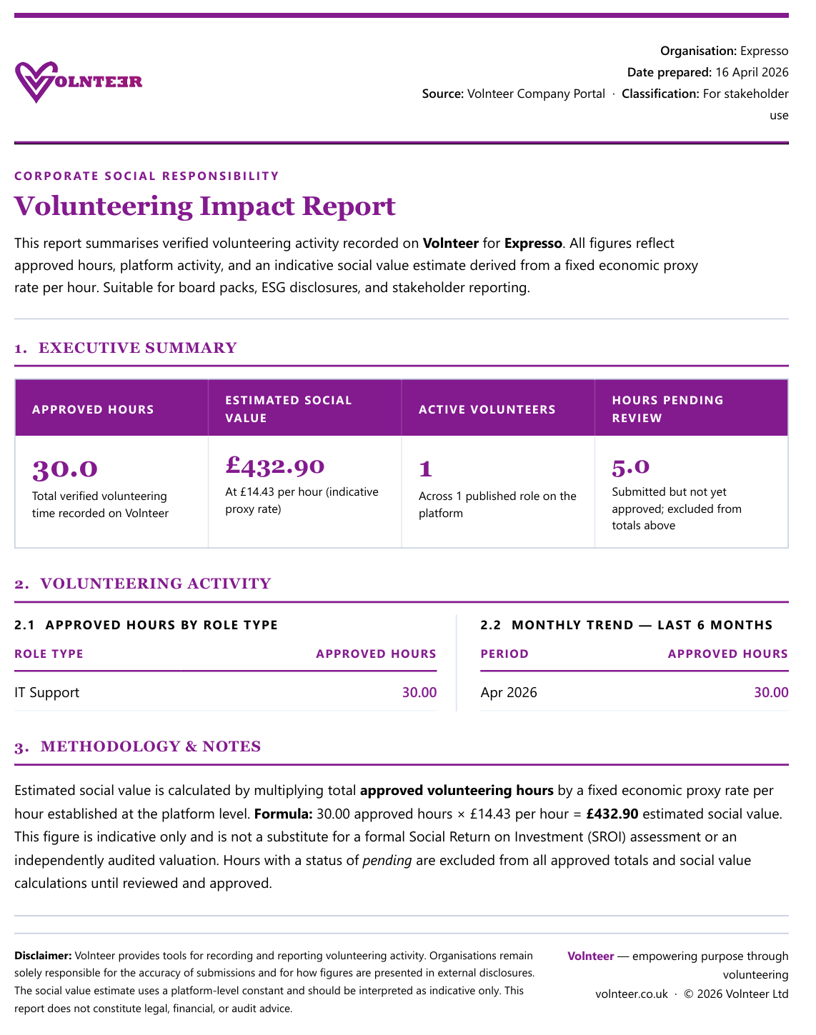
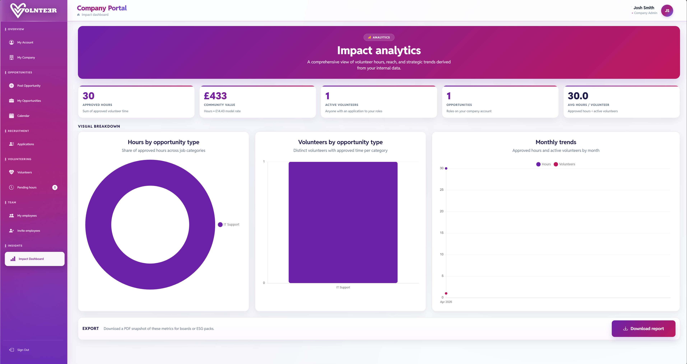

This is an example of our CSR Report
This is the Impact Dashboard
These are our features

Slide 7
Launch to Impact in 4 Steps
1
2
3
4
This is an example of our CSR Report
APPROVE
REPORT
SET UP
POST
Company Profile
& Team Access
Opportunities &
Manage Applications
Volunteer Hours Through
Clear Workflow
Analytics &
Export Reports
Register, configure your workspace, and invite team members with role-based access.
Publish volunteer roles and move applicants through your pipeline — shortlist to hired.
Volunteers submit hours. Your team approves or rejects in the Hours Portal.
Review live KPIs on the CSR dashboard. Export PDF snapshots for ESG packs.

Slide 8
HOW IT WORKS
Launch to Impact in 4 Steps
1
2
3
4
SET UP
POST
APPROVE
REPORT
Company Profile
& Team Access
Opportunities &
Manage Applications
Volunteer Hours Through
Clear Workflow
Analytics &
Export Reports
Register, configure your workspace, and invite team members with role-based access.
Publish volunteer roles and move applicants through your pipeline — shortlist to hired.
Volunteers submit hours. Your team approves or rejects in the Hours Portal.
Review live KPIs on the CSR dashboard. Export PDF snapshots for ESG packs.
Notes:
Volnteer is built for practical rollout: simple setup, guided operations, measurable output.

Slide 9



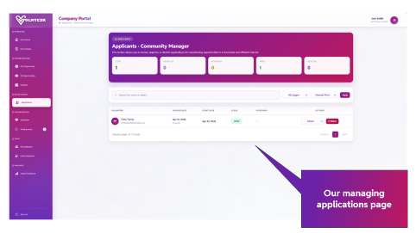
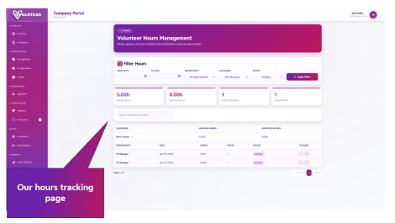
PROOF
Built for Reliable Reporting
and Control
Role-Based Workflows
Company admins and reps operate within structured access — no data leakage, no confusion.
Structured Application Stages
Shortlist → Interview → Hired. Every stage is trackable and reversible.
Approval-Based Hour Logging
Only approved hours count. Pending and rejected states maintain full data quality.
Dashboard + Downloadable Reports
Live KPIs and one-click PDF output — ready for board packs and ESG disclosures.
"Your data is operationally controlled, reviewable, and ready for stakeholder conversations."
Notes:
Your data is operationally controlled, reviewable, and ready for stakeholder conversations.

Slide 10
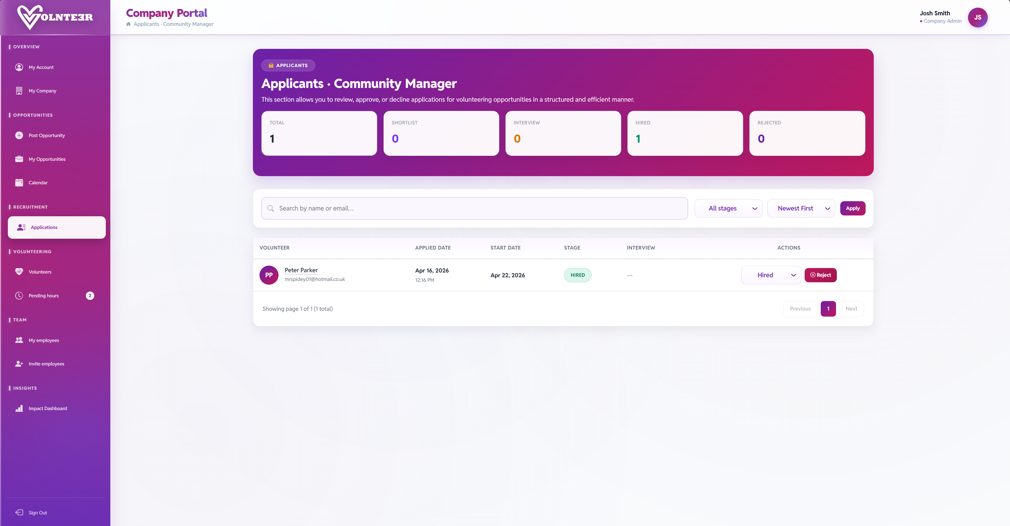
Our managing applications page

Slide 11
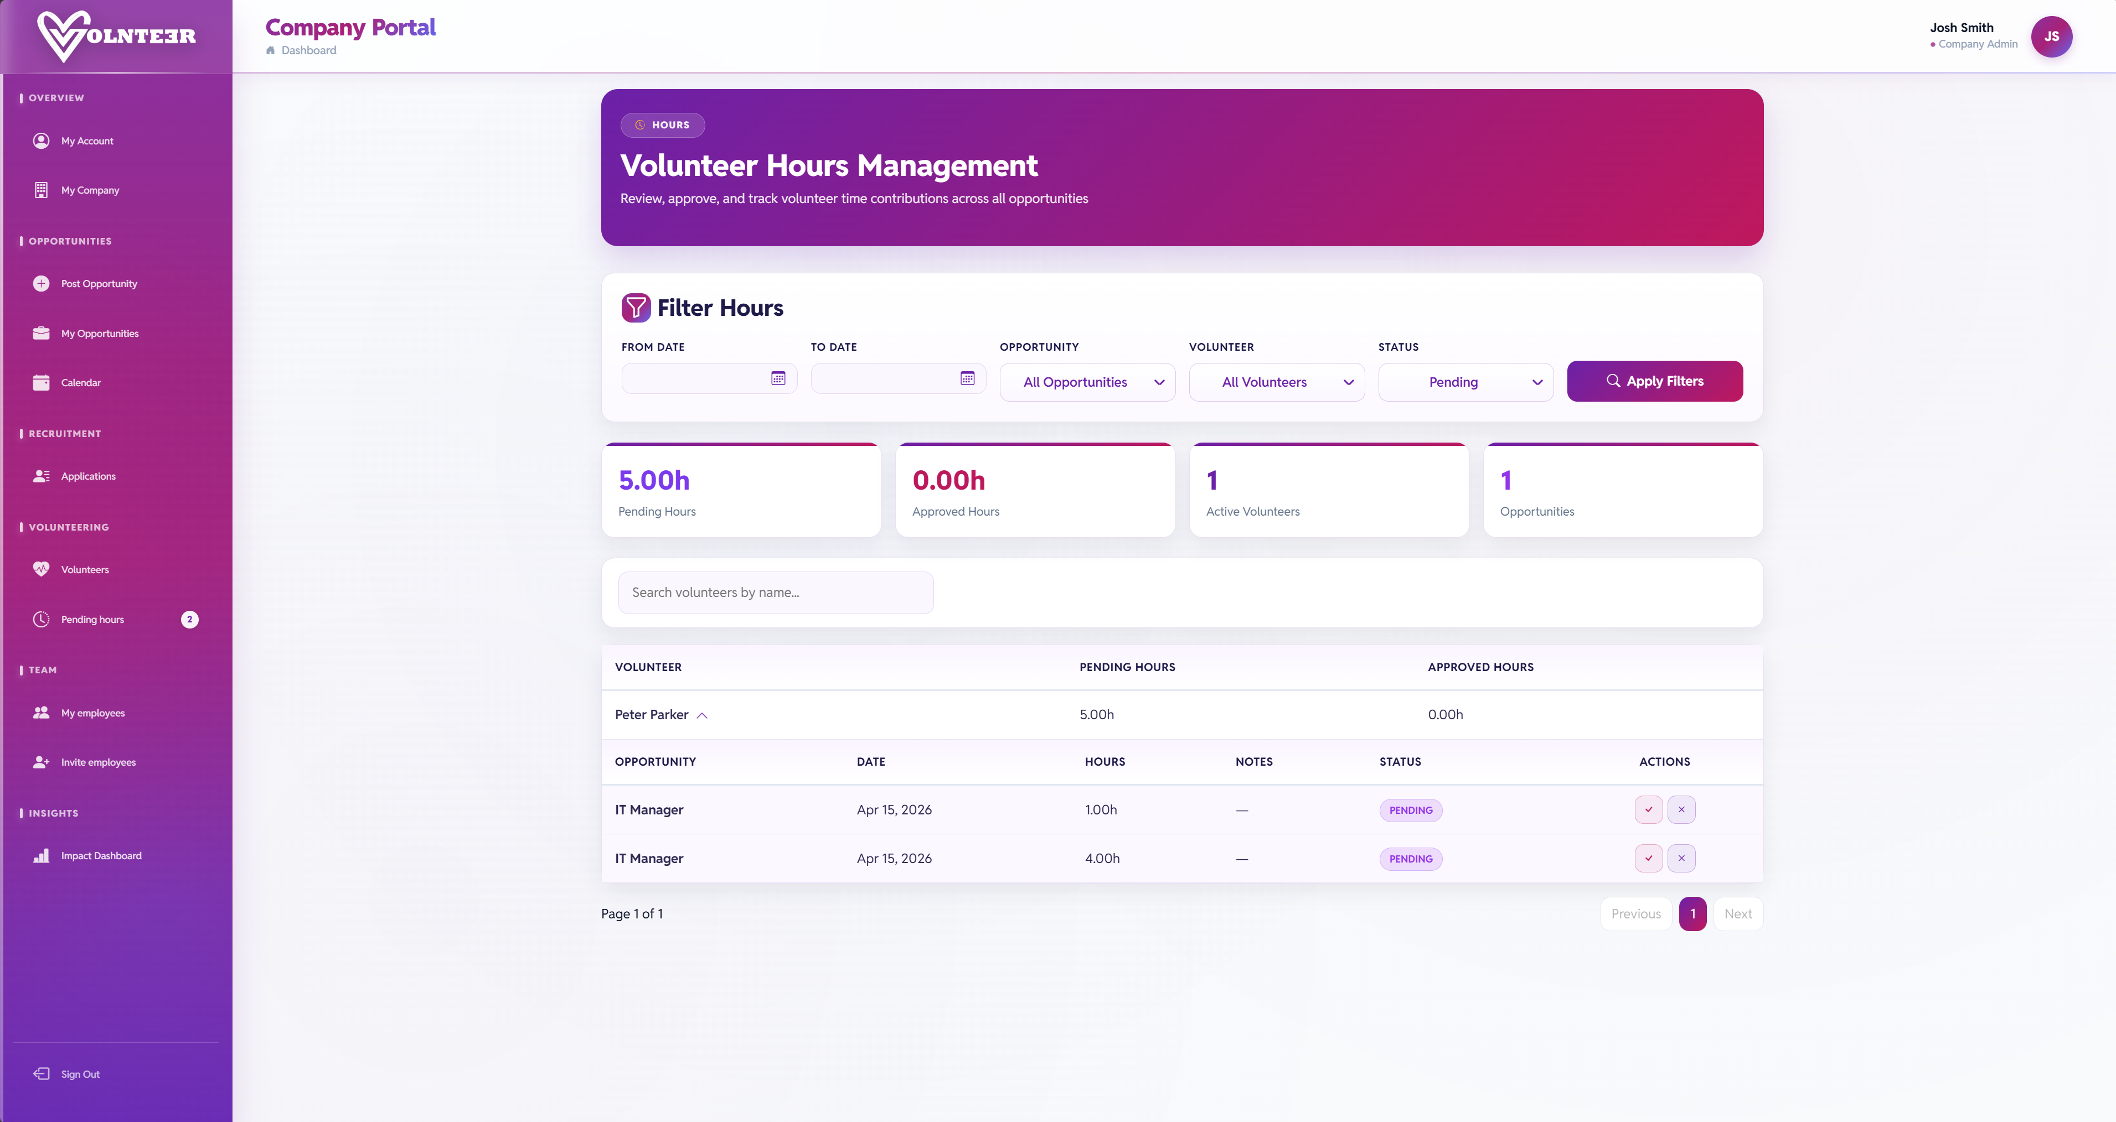

OUTCOMES
Outcomes Your Business
Can Communicate
Higher Participation
Cleaner Process Governance
More employees engaged in structured volunteering programmes.
Consistent approvals, auditable records, and role-based accountability.
Stronger Employer Brand
Credible CSR Storytelling
Credible community positioning that supports talent attraction and retention.
Outcome reporting backed by tracked metrics — not just activity counts.
"Volnteer helps you move from activity reporting to outcome reporting."
Our hours tracking page

Slide 12
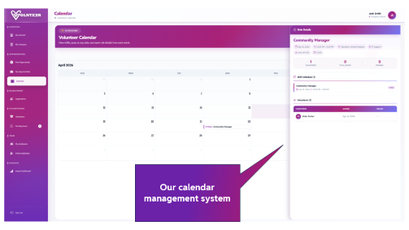
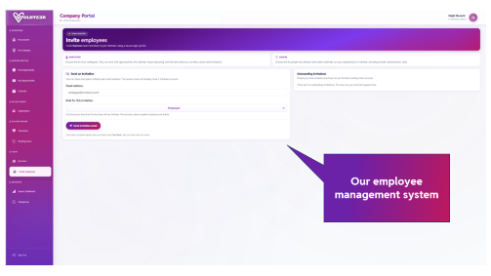
OUTCOMES
Outcomes Your Business
Can Communicate
Higher Participation
Cleaner Process Governance
More employees engaged in structured volunteering programmes.
Consistent approvals, auditable records, and role-based accountability.
Stronger Employer Brand
Credible CSR Storytelling
Credible community positioning that supports talent attraction and retention.
Outcome reporting backed by tracked metrics — not just activity counts.
"Volnteer helps you move from activity reporting to outcome reporting."
Notes:
Volnteer helps you move from activity reporting to outcome reporting.

Slide 13
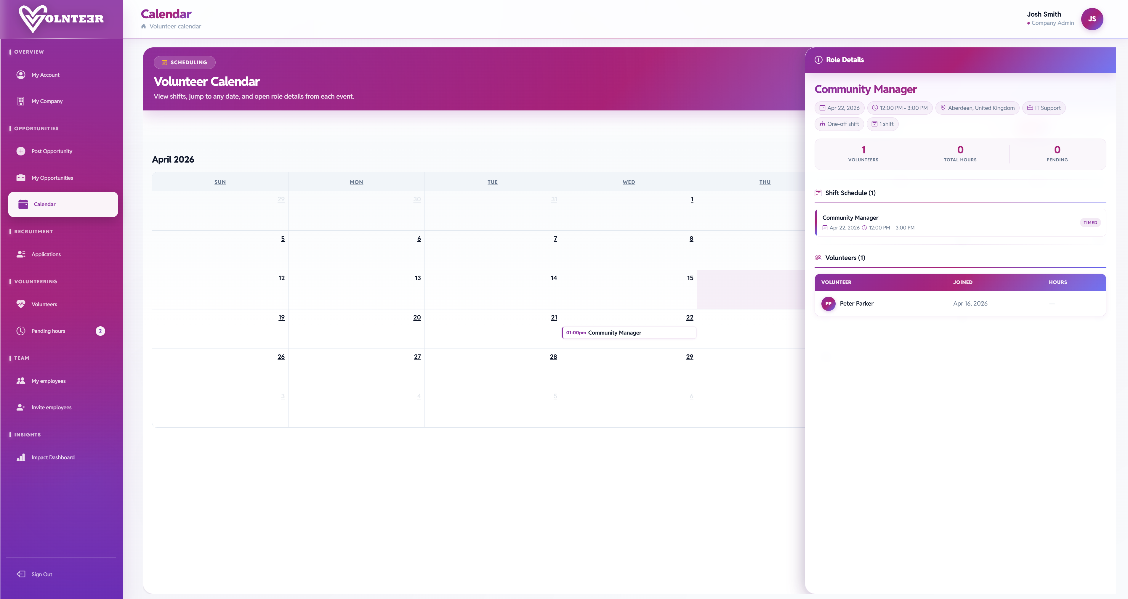
Our calendar management system

Slide 14

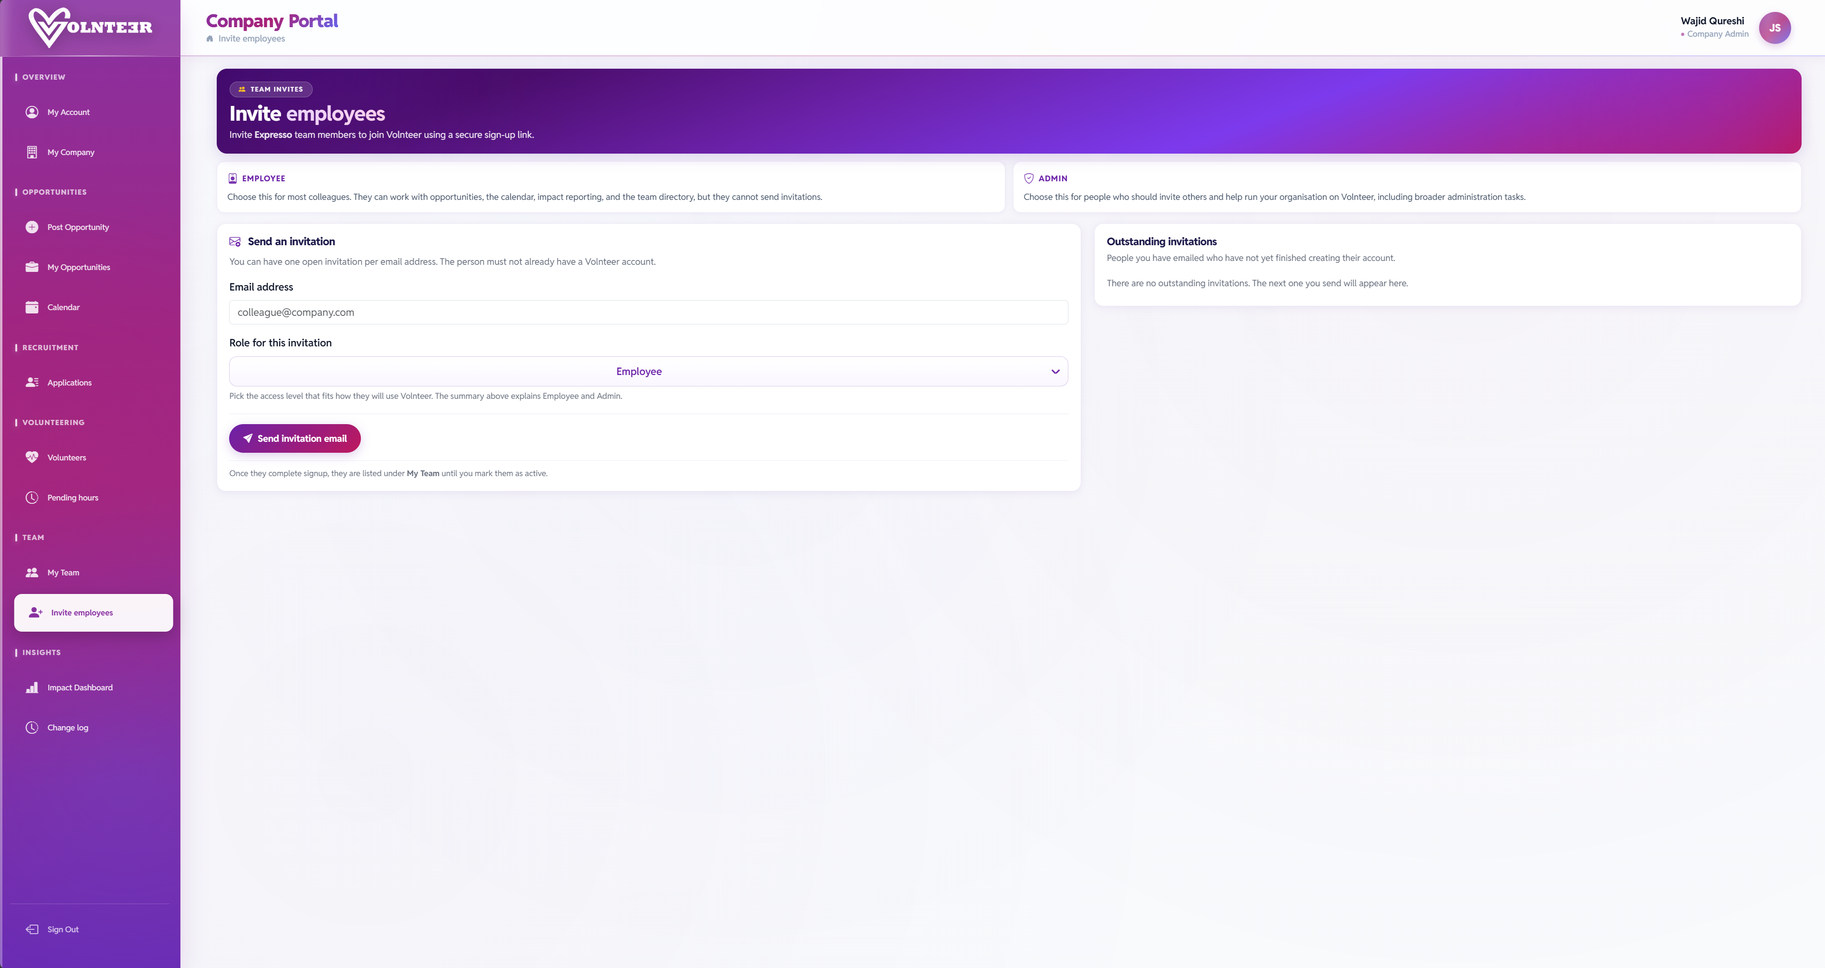

Start Small.
Prove Value.
Scale Fast.
Waj Qureshi & Vas Rabani
2
Run a 30–60 Day Cycle
1
Pilot with One Department
Let volunteers engage, submit hours, and build momentum.
Choose one team or location to start the programme.
4
Expand With Confidence
3
Review KPIs
Scale across the organisation with proven data behind you.
Assess engagement, approved hours, and community impact.
Our employee management system
(Founders)

Slide 15
Start Small.
Prove Value.
Scale Fast.
1
Pilot with One Department
2
Run a 30–60 Day Cycle
Choose one team or location to start the programme.
Let volunteers engage, submit hours, and build momentum.
3
Review KPIs
4
Expand With Confidence
Assess engagement, approved hours, and community impact.
Scale across the organisation with proven data behind you.
Waj Qureshi & Vas Rabani
(Founders)
Notes:
Give us one pilot team, and we'll help you demonstrate measurable volunteering impact your leadership can act on.

